Slide 1
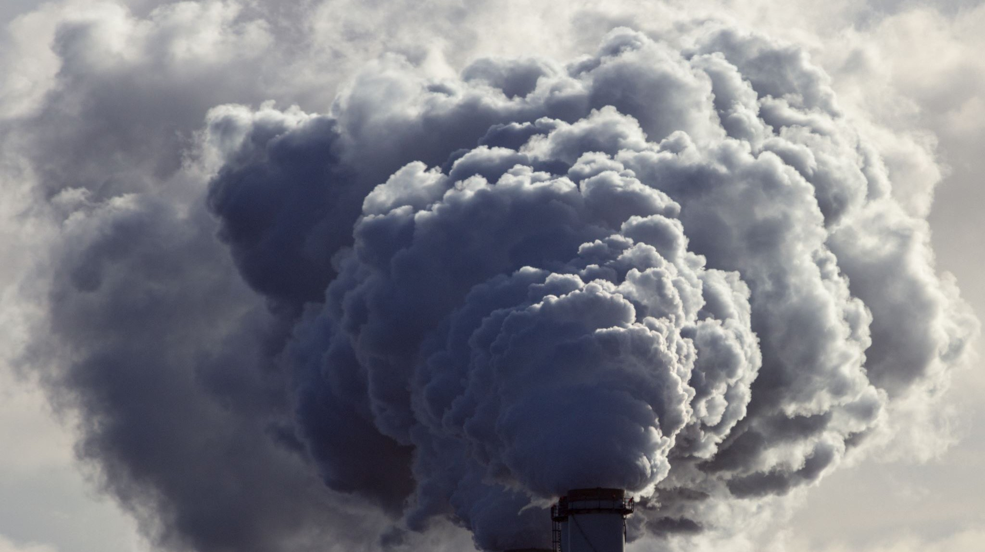

Analysis of CO₂ emissions from passenger cars in Europe
MAY 2023
Sethuraman B

Slide 2




Executive Summary
PAINPOINT: VISION OF THE ISSUE
CONTEXT
AMBITION AND ADDED VALUE
ANALYSIS FRAMEWORK
The EU aims to have zero-emission cars by 2035. In 2021, average CO2 emissions were 114.7 g/km.
The automotive industry is a complex system with many stakeholders: The stakeholders include environmental agencies, car manufacturers, governmental institutions, and car buyers.
Identify the most significant variables that affect the CO2 emissions of new registered cars.
Find the types of cars that emit the least CO2.
The analysis will be developed using public datasets by the European Environmental Agency (EEA) and several indicators.
https://news.berkeley.edu/2022/09/01/social-cost-of-carbon-is-more-than-triple-the-federal-estimate-study-finds/
2

Slide 3




Painpoint
Carbon dioxide (CO₂) is a colourless, odourless and non- poisonous chemical that is part of the greenhouse gases. One source of production of this compound is by the burning of fossil fuels.
The increment of greenhouse gases has led to an increment in the Earth mean temperature, which can be harmful for biodiversity, increase of fires, decreasing crop yields and people’s health.
In 2017, transportation was the second source of contamination of CO2 to the atmosphere with 15%, behind heating and electricity production with 31% according to the Center for Climate and Energy Solutions.
Increase of 2°C in less than three centuries!
One way to reach this is by reducing passenger cars CO₂ emssions
By 2030, under the Paris agreement, the EU commited to reduce greenhouse emissions by at least 40% below 1990 levels by 2030 and be climate neutral by 2050.⁴ There is a social cost associated to agriculture, extreme heat, energy expenditures and sea-level rise.
1.https://ec.europa.eu/eurostat/statistics-explained/index.php?title=Glossary:Carbon_dioxide_emissions 2.https://www.europarl.europa.eu/news/en/headlines/society/20180703STO07129/
3. https://www.c2es.org/content/international-emissions/
PAINPOINT

Slide 4




Historical CO₂ New Registered Passenger Car Emissions in gCO₂/km and Targets
200
CO2 Emission Target
180
172
TREND
170
167
166
164
162
161
160
158
154
146
140
Specific CO₂ Emissions (gCO₂/km)
136
140
132
130
Missed targets
127
123
122
120
118 118
121
Exception year 2020 due to the pandemic.
120
115
108
100
95
81
80
60
59
2023-2035?
40
20
0
0
2000 2001 2002 2003 2004 2005 2006 2007 2008 2009 2010 2011 2012 2013 2014 2015 2016 2017 2018 2019 2020 2021 2022 2023 2024 2025 2026 2027 2028 2029 2030 2031 2032 2033 2034 2035
Year
Data Source: EEA
PAINPOINT
4
https://www.eea.europa.eu/data-and- maps/data/co2-cars-emission-22

Slide 5





Stakeholders
Context
European Environment Agency (EEA)
Sets the limits of carbon dioxide emissions to car Manufacturers
Receives information of new car registers from Governmental Institutions and publish it.
Governmental Institutions
Responsible in requesting information of new passenger cars to car manufacturers.
Give this information before the end of February yearly to the EEA.
give information to
set limits to
give information to
Car Manufacturers
Car Users
Responsible in offering alternatives to users.
Give information of new registration to governmental institutions
produce new tech to
Responsible in deciding which car to buy.
Their decision may contribute to a low or high production of CO2 emissions.
CONTEXT

Slide 6

Ambition and added value
Stakeholder Added value Expected value
European Environmental Agency
Identify the variables and understand the problem to reach zero emissions by new cars in 2035
Medium
Car Manufacturers
Benchmark with other car manufacturers and get insights of the customer car purchase behaviors
High
Contribute with a sustainable world by identifying and buying cars with less emissions
Car Users
Medium
Reduction of the economical cost associated to CO2 emissions produced by cars
Governmental Institutions
High
AMBITION AND ADDED VALUE

Slide 7
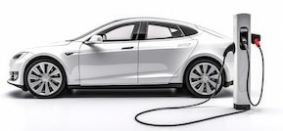
Data Universes and Sets
Main Variables found in the analyzed Data Sets
Variable | Description | Units | Type
ID | Registration number | 9920108 registered cars | character
Membrer State | EU countries, Iceland and Norway | 29 European countries | character
Manufacturer Name | Car manufacturer | 97 manufacturers | character
Mass in running order | Mass of the car | kg | numeric
Specific CO2 emissions | Grams of CO2 emitted by km covered | g/km | numeric
Fuel type | Combustible | 10 fuel types | character
Engine Capacity | Size of the engine | cm3 | numeric
Engine Power | Capacity of electric car | kW | numeric
Fuel consumption | Liters of fuel consumed by km | L/100 km | numeric
Wheel Base | Horizontal distance between fronts and rear wheels | mm | numeric
Axle width steering axle | Distance between centerline of two wheels same axle | mm | numeric
Axle width other axle | Distance between centerline of two axles | mm | numeric
Electric energy consumption | km covered by Wh | Wh/km | numeric
Electric range | km covered with one charge | km | numeric
Data Universes: Transportation
Main Dataset:
CSV file of new registered cars in 2021
More than 40 variables
9.02 million rows
Type of variables: numeric, character and logical.
CO2 emissions from new passenger cars registered in EU27, Iceland (from 2018) and Norway (from 2019) – Regulation (EU) 2019/631.
Other Data Sets:
Years from 2016-2020 (up to 15 million rows per year)
Bridges using fuel-type and manufacturer information.
Data sources
EEA Data: Monitoring of CO2 emissions from passenger cars – Regulation (EU) 2019/631 provided by European Environment Agency (EEA)
Application data last refreshed 22 September 2022 14:42 PM. Version info eeacms/esbootstrap:v3.1.5 and tag version v3.1.5 on elastic7-app-CO2-cars-esapp-1.
Sources: Statista| Global CO2 emissions from passenger cars 2020 | Statista
Europa.eu | Electric road vehicles in the European Union (europa.eu)
AMBITION AND ADDED VALUE

Slide 8


Insights from Analysis of Data
Number of new passenger cars registered
Reduction in registrations
Millions of Registrations
20
last three years
15
15.27
15.50
11.60
10
9.92
5
5.00
0
2019
Year
Percentage of New Car Registrations by Fuel Type 2016-2021
2017
2018
2020
2021
70.00%
Mean Emissions gCO₂/km in 2021 Top
60.00%
Reduction in petrol car registration last three years, but they keep at least 50% of new registrations.
pollutant | Type | Emissions
1 | E85 | 160
2 | Diesel | 144
3 | Petrol | 135
4 | LPG | 121
5 | NG/Biomethane | 113
%Registrations by Type of Fuel
50.00%
40.00%
Diesel car usage is reducing.
30.00%
6 NG 105
Target 2021: 95
7
8
9
9
Petrol/Electric Diesel/Electric Electric Hydrogen
42
39
0
0
20.00%
Aligned with goal in 2035
Electric cars are more required for consumers, as well as variants such as petrol/electric and diesel/electric.
10.00%
Other alternatives as LPG and Hydrogen fuels are
demanded for car users, but in low quantities.
IMPORTANT: Considering social cost of $185 for each ton/CO2 produced, and a mean of 20,000 km covered by car and the almost 10 million new car registers in 2021, the CO₂ cost was around 3.91 billion of euros in that year.
0.00%
Petrol
Diesel
Electric Petrol/Electric
2016 2017 2018 2019 2020 2021
LPG
Others
ANALYSIS AND FRAMEWORK

Slide 9

Key Factors
Key Success Factors
Key Performance Indicators
Main Goal
Identify significative variables in car CO2 emissions
Significance of independent variables (P-value)
Develop a 3- Scenario Analysis to reach target in 2023 using historical data
Reduction of new registered car CO₂ emissions
3 different scenarios with CO2 below 95gCO₂/km
Years gCO₂/km
2023-2024: 95
2025-2029: 81
2029-2034: 59
Propose ideas to reach goals 2025-2035
3 ideas to
reach 81, 59
and 0 gCO₂/km
2035-onwards: 0
AMBITION AND ADDED VALUE

Slide 10



Hypothesis
Hypothesis 1
Hypothesis 2
Hypothesis 3
Petrol cars are the most registered in 2016-2021 records.
Electric cars (and electric-hybrid) demand is increasing in 2016-2021 records.
The heavier, more powerful, and less fuel-efficient a petrol car is, the more CO2 it will emit.
The wheelbase and axles distances also affect CO2 emissions, but to a lesser extent.
AMBITION AND ADDED VALUE

Slide 11

Objective 1: Identify significative variables in car CO2 emissions
Significance Analysis Petrol/Diesel Type Cars Data 2021 Response variable: specific CO₂ emissions
No. | Independent Variable | Estimate | P-Value
1 | Fuel consumption (L/100km) | 10.02 | 2E-16
2 | Axle width steering axle (mm) | 0.07766 | 2E-16
3 | Wheel Base (mm) | 0.06931 | 2E-16
4 | Mass (kg) | 0.05465 | 2E-16
5 | Engine Capacity (cm3) | 0.02546 | 2E-16
Key Success Factors
Key Performance Indicators
More significative
Identify significative variables in car CO2 emissions
Significance of independent variables (P-value)
Data from petrol and diesel was considered since they represent almost 80% of the new registrations in 2021 (Pareto principle).
Top 10 Least Pollutant Car Manufacturers
Top 10 Most Pollutant Car Manufacturers
120.00
CO2 Emission
7.00
600.00
CO2 Emission
25.00
Mean of 95.2g/CO2
Fuel Consumption
100.00
6.00
500.00
20.00
5.00
Mean of 340.30g/CO2
80.00
400.00
gCO₂/km
4.00
L/100km
gCO₂/km
15.00
L/100km
60.00
300.00
3.00
10.00
40.00
2.00
200.00
20.00
1.00
100.00
5.00
0.00
0.00
0.00
0.00
Geely
Hyundai
Kia
Nissan
PSA
Volvo
Renault
Dacia
Bugatti
Pagani
Ferrari
Bentley
Mitsubishi
Suzuki Thailand
Koenigsegg
Rolls Royce
Lamborghini
Aston Martin
Renault Trucks
Mercedes AMG
ANALYSIS AND FRAMEWORK

Slide 12
Countries grouped and sorted by their average emissions to identify market trends and opportunities.
Country segmentation
Avg emissions by country (gCO2/km) - WLTP
Percentage of new
cars being electric
WLTP CO2 emissions
per citizen
GDP per capita ($)
Country
Each dot represents a particular country. The countries are clustered based on their GDP on the x-axis and the percentage of new cars being electric on the y-axis. The purple colour indicates countries that need to be targeted first. Then, the blue and orange colours indicate new potential opportunities to be pursued. Finally, the green countries will have the lowest priority.
Each bar represents a particular country. The length of the bar shows the average CO2 emissions per citizen per country. Considering the Paris Agreement, countries with high emissions will sooner or later need to take actions to control their carbon footprint, thus will effectively create new opportunities for the EV and EV charging industry.
ANALYSIS AND FRAMEWORK

Slide 13

Objective 2: Develop a 3- Scenario Analysis to reach target in 2023 using historical data
Main Goal
Years gCO₂/km
2023-2024: 95
Base Case Scenario 2023
Fuel Type | Market Share | gCO2/km
Petrol | 48% | 135
Diesel | 15% | 144
Electric | 19% | 0
Petrol/Electric | 15% | 42
 | 97% | 92.7
Key Success Factors
Develop a 3- Scenario Analysis to reach target in 2023 using historical data
Key Performance Indicators
Exponential increase of electric cars market share (MS) from 10.1 to 19%
Linear decrease of petrol and diesel car MS, from 55.5 and 22.6 to 48 and 15% respectively.
Economical of reduction of 620 millions Euros
associated social cost of CO₂ emissions.
Increase registration of petrol low emission manufacturers cars (135 to 125 gCO₂/km)
Exponential increase of electric cars (MS) from
10.1 to 21%.
Linear decrease of petrol and diesel car MS from 55.5 and 22.6 to 46 and 14% respectively.
Economical reduction of 900 millions Euros associated social cost of CO₂ emissions.
Linear increase of electric cars (MS).
Small decrease of petrol and diesel car MS.
Economical reduction of Economical reduction of 300 millions Euros associated social cost of CO₂ emissions. .
3 different scenarios with CO2 below 95gCO₂/km
Historical Scenario in 2021
Fuel Type | Market Share | gCO2/km
Petrol | 55.5% | 135
Diesel | 22.6% | 144
Electric | 10.1% | 0
Petrol/Electric | 8.5% | 42
 | 96.7% | 111.0
Best Case Scenario 2023
Fuel Type | Market Share | gCO2/km
Petrol | 46% | 125
Diesel | 14% | 144
Electric | 21% | 0
Petrol/Electric | 16% | 42
 | 97% | 84.4
Petrol and diesel Market Share in 2021 was 77%. With electric and hybrid cars made up to 97%.
Simulating three differente market share simulations can change the gCO2/km, keeping data from emissions 2021.
Worst Case Scenario 2023
Fuel Type | Market Share | gCO2/km
Petrol | 52% | 135
Diesel | 19% | 144
Electric | 15% | 0
Petrol/Electric | 11% | 42
 | 97% | 102.2
ANALYSIS AND FRAMEWORK

Slide 14

Objective 3: Propose ideas to reach goals 2025-2035
Main Goals
Economical of reduction by 2035 with zero car emissions of 3.91 billion Euros associated social cost of CO₂ emissions (agricultural damage, heating, cooling, sea level rise, etc.)
Reduction of new registered car CO₂ emissions
Key Success Factors Key Performance Indicators
Years
2023-2024:
2025-2029:
gCO /km
2
95
81
2029-2034: 59
2035-onwards: 0
Propose ideas to reach goals 2025-2035
3 ideas to reach 81, 59
and 0 gCO₂/km
2025-2029
2030-2034
2035-onwards
5%
10% 10%
100% zero emission cars
5%
15%
Electric and hybrids more than 50%
20%
30%
25%
10%
Electric and hybrids more than 75%
35%
50%
85%
Petrol Diesel Electric Petrol/Electric Others
In the period 2025-2029, a significative decrease of fossil fuel types cars must occur, and an increase in MS of zero carbon dioxide emission cars of more than 50% to reach less than 81gCO₂/km
Petrol
Diesel Electric Petrol/Electric Others
Between 2030-2034, an increase of electric and hybrid electric cars up to 75% of the market share to make possible less than 59gCO₂/km
Other zero emission alternatives must be adopted
Electric Others
By 2035, 100% zero emission new registered cars. Electric, hybrid electric and other types: hydrogen, etc.
ANALYSIS AND FRAMEWORK

Slide 15

Success defined by 3 key factors that are measurable
Contribute to a sustainable future
KEY SUCCESS FACTORS
KEY PERFORMANCE INDICATORS
Limits
Data: It was required to find additional data sources to understand data sets and complete them.
Gain market share in the
EV charging infrastructure
Number of new charging points with respect to the totals installed
Knowledge:
Specific technical terms.
Tools for creating good graphics
Achieve financial growth
Reach up to €425m revenue from the EU budget
How to address these limits?
Different sources of information needed
Contribute to net zero emissions
CO2 emissions by country fall each year
ANALYSIS AND FRAMEWORK

Slide 16
Recommendations
1. European Environment Agency (EEA)
Keep sharing information yearly with insights about new car registrations.
Request governmental institutions to prioritize targets for CO₂ emission.
2. Governmental Institutions
Reward/punish car manufacturers to invest in new technologies for reducing CO₂ emissions in new cars.
Raise awareness in car users to migrate to low or zero CO₂ pollutant cars.
4. Car Users
Change purchase behavior to zero emission cars, such as electric or hydrogen.
If not possible, migrate to hybrid- electric cars or petrol with low emissions.
3.Car Manufacturers
Implement new technologies to reduce carbon dioxide emissions in new cars.
Invest in R&D to develop new car alternatives with zero emissions.
ANALYSIS AND FRAMEWORK

Slide 17
Mission “Electrify” will pave the way towards a sustainable future for humanity and market growth……….
Thank You!

